Slide 1
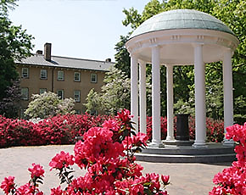
Fire Safety in Fraternities and Sororities Chapel Hill Fire Department Inspections Program
Greek Life Fire Inspection Program

Slide 2
PURPOSE: “YOUR SAFETY”
Greek Life Fire Inspection Program

Slide 3
Mother’s Day and Graduation Day May 12, 1996
Approximately 06:10 am, a fraternity neighbor awoke, saw the smoke, and called in the fire
Greek Life Fire Inspection Program

Slide 4
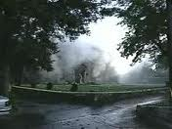
Greek Life Fire Inspection Program

Slide 5
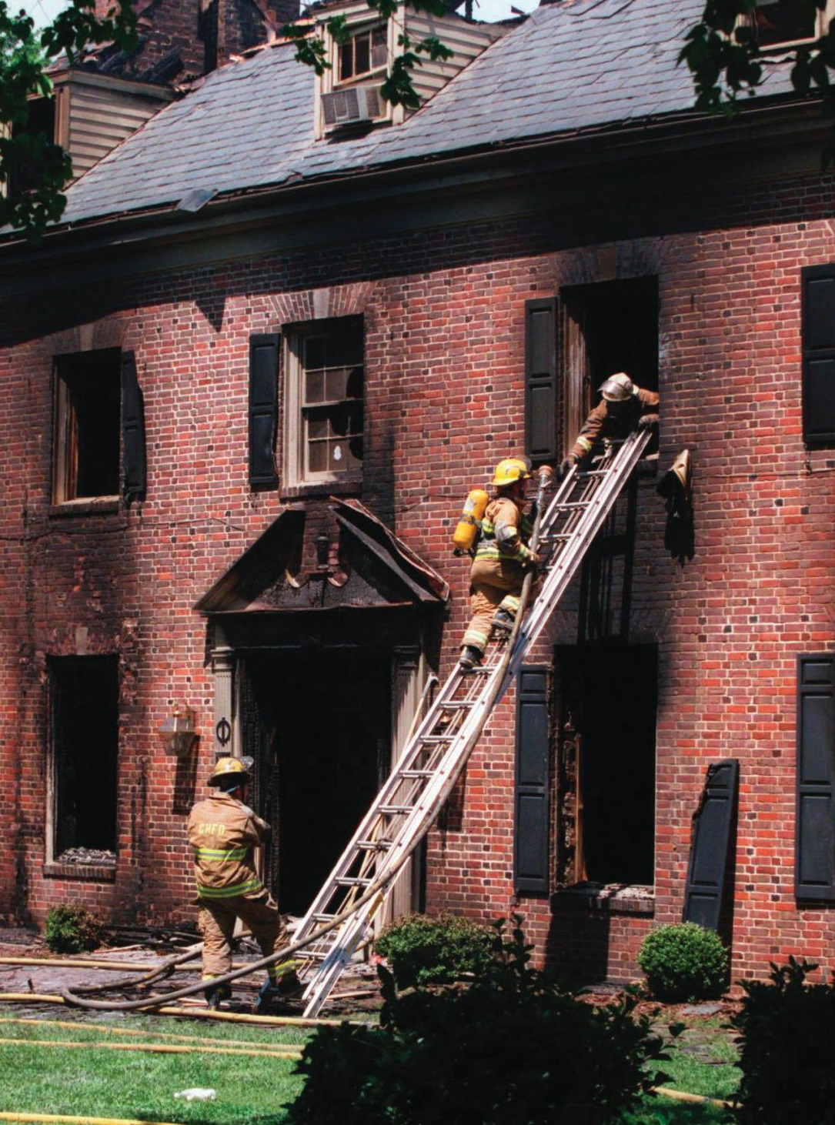
Initial responding units found heavy smoke and fire conditions
Three occupants escaped the fire
The fire crews attempted to enter the fraternity
Greek Life Fire Inspection Program

Slide 6
Loss of Life
Five Students lost their lives
Three students injured, one critically
Fire most likely attributed to improperly extinguished smoking materials placed in trash can
Greek Life Fire Inspection Program

Slide 7
Loss of Life
Greek Life Fire Inspection Program

Slide 8
THE FIRE PROBLEM
COMMON CAUSES OF FIRES IN STUDENT RESIDENCES
( on and off campus )
Inappropriately Discarded Smoking Materials
Falling Asleep While Smoking
Ignited Materials Left Unattended
Inadequate Control Of An Open Flame
Combustible Material Too Close To A Heating Element
Improper Cooking, Burning food items
Overloaded Electrical Outlets
Notes:
If you can eliminate these causes and have a clean and violation free inspection you will greatly reduce your chances of a fire

Slide 9
CHFD Expectations
Sign up for drill/inspection today
Every F.M. will have completed their self inspection (Greek Life website)
Meet us on time for the drill and inspection
Unannounced drill-tell no one
Make sure all occupants are out of the house during drill
Have all keys for locked doors
If violation exist, schedule follow up time
Notes:
If you can eliminate these causes and have a clean and violation free inspection you will greatly reduce your chances of a fire

Slide 10
Parties and Social Events
Tent use requires a permit
No construction of combustible materials in the house, sawdust, wood, plastic, fog machines
Someone who is not drinking monitor the house
No disguising exits
No mazes in the house
No blocking of exits
Notes:
If you can eliminate these causes and have a clean and violation free inspection you will greatly reduce your chances of a fire

Slide 11
Parties and Social Events
Notes:
If you can eliminate these causes and have a clean and violation free inspection you will greatly reduce your chances of a fire

Slide 12
Parties and Social Events
Notes:
If you can eliminate these causes and have a clean and violation free inspection you will greatly reduce your chances of a fire

Slide 13
Parties and Social Events
Notes:
If you can eliminate these causes and have a clean and violation free inspection you will greatly reduce your chances of a fire

Slide 14
Parties and Social Events
Notes:
If you can eliminate these causes and have a clean and violation free inspection you will greatly reduce your chances of a fire

Slide 15
Parties and Social Events
Notes:
If you can eliminate these causes and have a clean and violation free inspection you will greatly reduce your chances of a fire

Slide 16
Parties and Social Events
Notes:
If you can eliminate these causes and have a clean and violation free inspection you will greatly reduce your chances of a fire

Slide 17
Parties and Social Events
Notes:
If you can eliminate these causes and have a clean and violation free inspection you will greatly reduce your chances of a fire

Slide 18
Parties and Social Events
Notes:
If you can eliminate these causes and have a clean and violation free inspection you will greatly reduce your chances of a fire

Slide 19
Parties and Social Events
Notes:
If you can eliminate these causes and have a clean and violation free inspection you will greatly reduce your chances of a fire

Slide 20
Parties and Social Events
Notes:
If you can eliminate these causes and have a clean and violation free inspection you will greatly reduce your chances of a fire

Slide 21
Parties and Social Events
Notes:
If you can eliminate these causes and have a clean and violation free inspection you will greatly reduce your chances of a fire

Slide 22
Parties and Social Events
Notes:
If you can eliminate these causes and have a clean and violation free inspection you will greatly reduce your chances of a fire

Slide 23
Violation/Citations
When these conditions exist:
Citation and a civil penalty of $500.00 will be issued and or criminal summons brought forward.
The event will be shut down until violations have been abated.
Tampering with the fire alarm system will not be tolerated
Notes:
If you can eliminate these causes and have a clean and violation free inspection you will greatly reduce your chances of a fire

Slide 24
WE WILL ADDRESS ALMOST EVERYTHING NEEDED FOR YOU TO HAVE A GREAT INSPECTION WITH NO VIOLATIONS

Slide 25
FIRE SAFETY EQUIPMENT
FIRE ALARM SYSTEM
SPRINKLER SYSTEM
FIRE EXTINGUISHERS
KITCHEN FIRE SUPPRESSION SYSTEM
EXIT AND EMERGENCY LIGHTS
DOORS AND LOCKS
Notes:
ITEMS WE WILL COVER

Slide 26
HOUSEKEEPING
TRASH IN HALLWAY/STAIRS
STORAGE, DRYER VENTS
EXTENSION CORDS, WIRING
CEILING TILES, HOLES IN SHEETROCK
OUTSIDE -BLOCKING EXITS-CARS
FIREPLACES
CLEARANCE AROUND GAS APPLIANCES

Slide 27
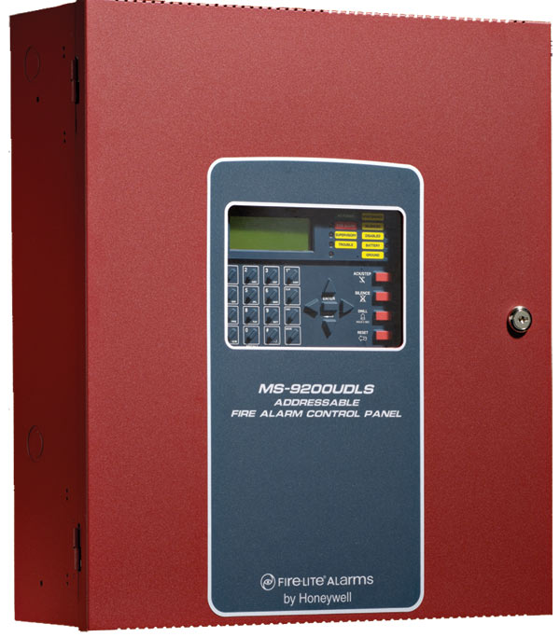
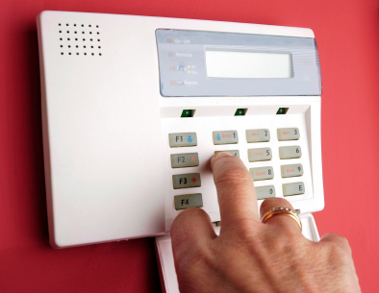
Fire alarm system
Greek Life Fire Inspection Program

Slide 28
Annual Inspection
Record of the last inspection from a qualified alarm company
The digital readout should be “normal conditions” or “READY”
No error messages or faults
If you have these conditions call a technician for repair
Greek Life Fire Inspection Program

Slide 29
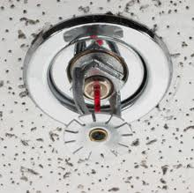
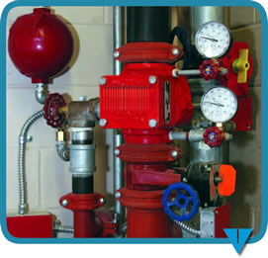
Sprinkler System
Greek Life Fire Inspection Program

Slide 30
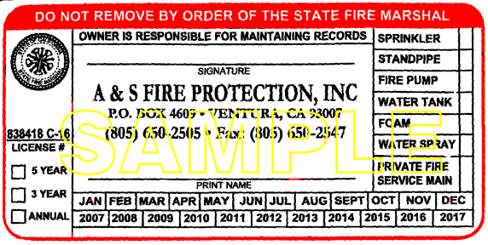
Annual Inspection
Record of the last inspection
The system should have an inspection tag attached
Greek Life Fire Inspection Program

Slide 31
Sprinklers cont…
Spare sprinkler heads in a box on the wall
Sprinkler wrench to replace the sprinkler heads
No storage or obstructions around the system
The sprinkler room is labeled if not obvious
Greek Life Fire Inspection Program

Slide 32
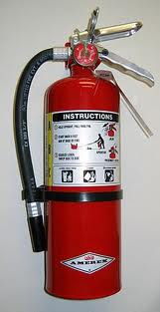
Fire Extinguishers
Greek Life Fire Inspection Program

Slide 33
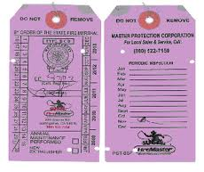
Annual Inspection
The pressure gauge needle should be in the green
area
The inspection tag should
indicate date of inspection
Shall be mounted
Greek Life Fire Inspection Program

Slide 34
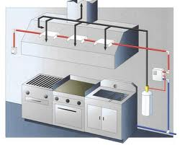
Kitchen Suppression System
Greek Life Fire Inspection Program

Slide 35
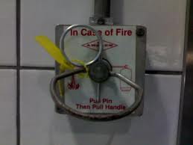
Semi Annual Inspection
Requires inspection by a fire extinguisher company 2 times a year
Must be tagged on the manual pull station
Cleaning schedule
Greek Life Fire Inspection Program

Slide 36
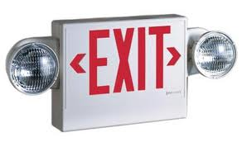
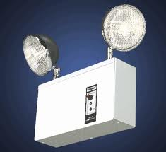
Exit and Emergency Lighting
Greek Life Fire Inspection Program

Slide 37
Annual and Monthly Checks
Once a year the lights must be tested and drained down for 90 minutes
Once a month they shall be tested to make sure they stay lighted on battery power
Greek Life Fire Inspection Program

Slide 38
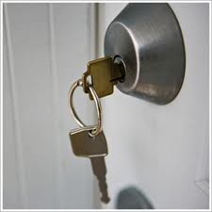
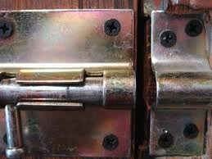
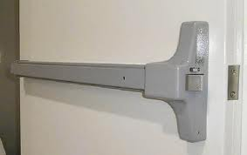
DOORS and Locks
Greek Life Fire Inspection Program

Slide 39
Door Locks and Latches
All exit doors are to be self closing and free of obstructions
CANNOT HAVE DOUBLE KEYED DEADBOLTS OR SLIDE BOLTS
No locks are allowed on doors with panic hardware
Greek Life Fire Inspection Program

Slide 40
Housekeeping/General Precautions
NO trash in Hallways or in Stairs
No missing ceiling tiles
No holes in sheetrock
Clean fireplaces before use
3 ft. clearance around gas appliances
Clean out behind dryers (lint)
Greek Life Fire Inspection Program

Slide 41
Housekeeping cont.
No excessive storage around your house or at exits or under outside stairs
Do all electrical outlets have faceplates
Smoking items disposed of properly
Greek Life Fire Inspection Program

Slide 42
FDC
Is your fire department connection to your sprinkler system visible and free of obstructions- bushes and trees
Is your FDC Sign Visible!
Greek Life Fire Inspection Program

Slide 43
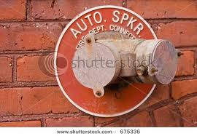
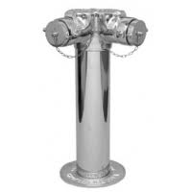
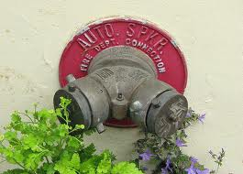
FDC and Signage
Greek Life Fire Inspection Program

Slide 44
Can You Find the Violations
Greek Life Fire Inspection Program

Slide 45
Greek Life Fire Inspection Program

Slide 46
Greek Life Fire Inspection Program

Slide 47
Greek Life Fire Inspection Program

Slide 48
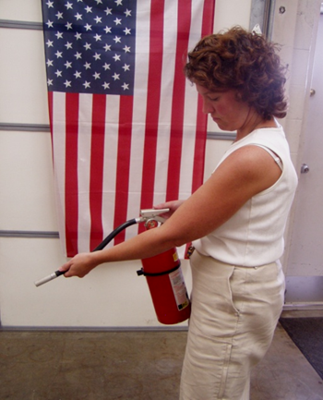
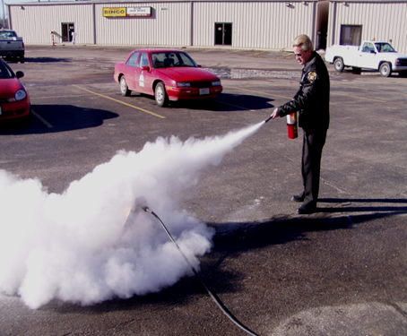
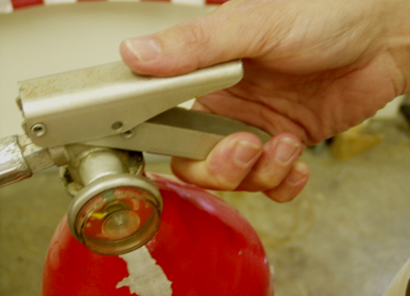
Fire Extinguishers… PASS Method
Greek Life Fire Inspection Program

Slide 49
THANK YOU FOR BEING THE HOUSE FIRE MARSHAL

Slide 50
Questions?
Concerns?
Greek Life Fire Inspection Program

